Slide 1
Capstone: NYC Daily Inmates In Custody
A Presentation By: Minping Mei (Devin) & Wendy Camacho
Notes:
Devin

Slide 2


Agenda
Python (Data Cleaning) General Data Cleaning
Tableau (Joins)
Tableau (Additional Data Cleaning: Calculated Field)
Findings (Tableau Dashboards and Stories)
Conclusion
Resources
Notes:
Devin

Slide 3
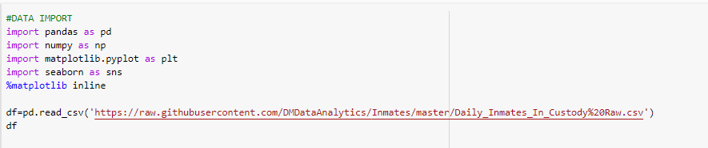
Python (Data Cleaning): Github
We started by uploading the dataset into Github and importing into Google Colab.
Notes:
Wendy

Slide 4
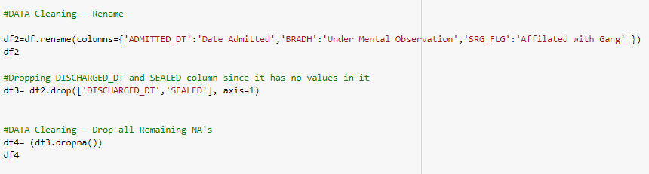
Python (Data Cleaning)
For data cleaning, we began by renaming columns to make them more easily understood. We then proceeded to drop columns with no values to optimize performance. Finally, we dropped all remaining Null values.
Notes:
Devin

Slide 5
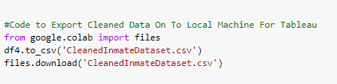
Python (Data Cleaning) : Export
Finding sample code online from StackOverFlow was needed to show us how to export from Colab to our local machines.
Notes:
Wendy

Slide 6
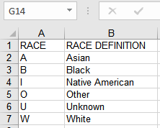
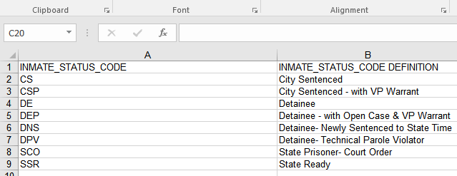
Tableau (Joins)
For some of the columns in our dataset, the values weren’t well defined and wouldn’t be of value to the audience. Defining of values was done on a seperate spreadsheet and joined to the original dataset.
Notes:
Devin

Slide 7
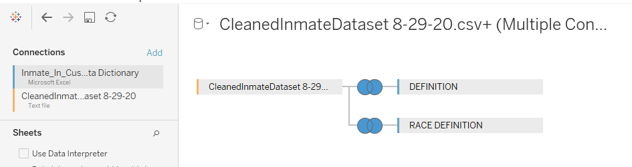
Tableau (Joins)
In order to not lose any usable data in population. We used a full outer join in Tableau without creating any null values.
Notes:
Wendy

Slide 8
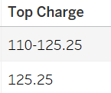
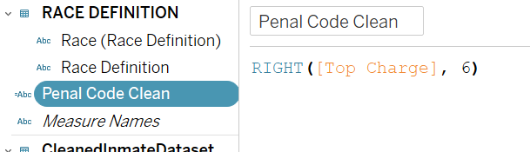
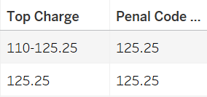
Tableau: Calculated Field
Charges 110-125.25 and 125.25 are the same but when trying to aggregate the data they show up as seperate charges.
Solution:
Result:
Notes:
Devin

Slide 9
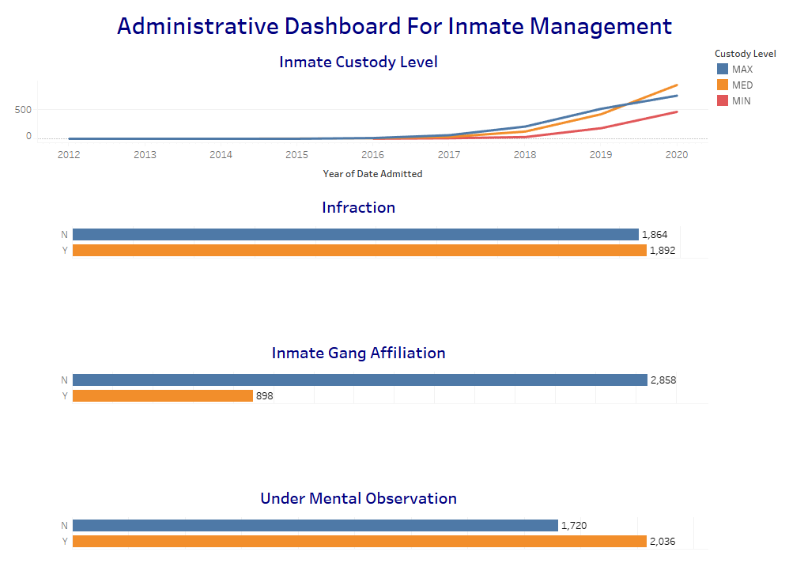
Tableau: Dashboards (General)
Findings:
Majority of Inmates are in Maximum and Medium Security (Custody Levels).
Fairly even distribution of those who committed and didn’t commit an infraction.
Majority of Inmate Population is Not Gang Affiliated.
More inmates under mental observation.
Notes:
Wendy

Slide 10
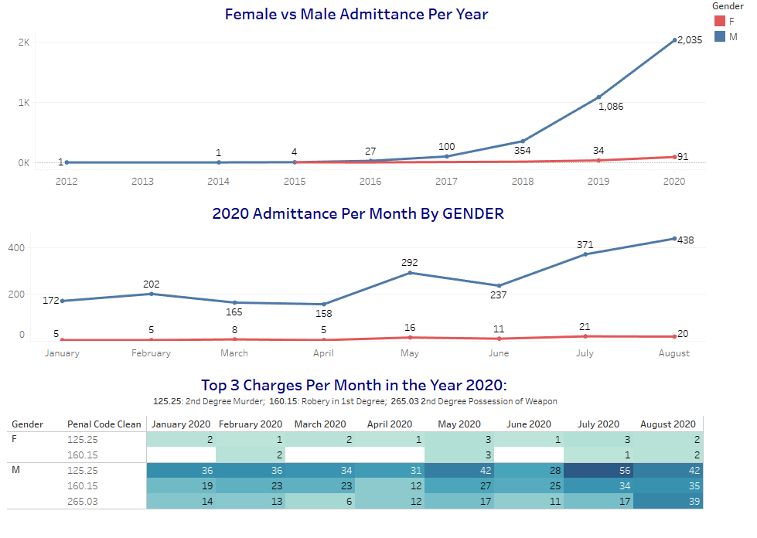
Tableau: Dashboards (Gender)
Findings:
Women didn’t start getting admitted until 3 years later (2015) in this particular data set.
Highest admittance year was 2020. The female admittance stayed around the same each month. The male admittance kept progressing with the highest month being August.
The top charge was 2nd degree murder with July being the highest recorded month.
Notes:
Devin

Slide 11
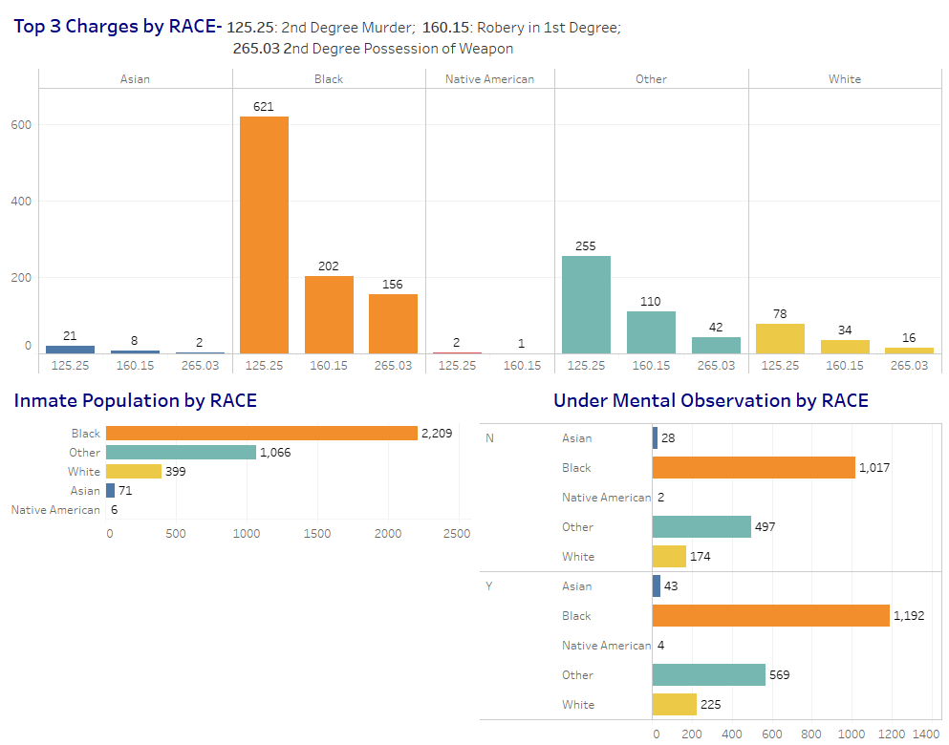
Tableau: Dashboards (Race)
Findings:
All races seem to have the same Top 3 Charges.
Notes:
Wendy

Slide 12
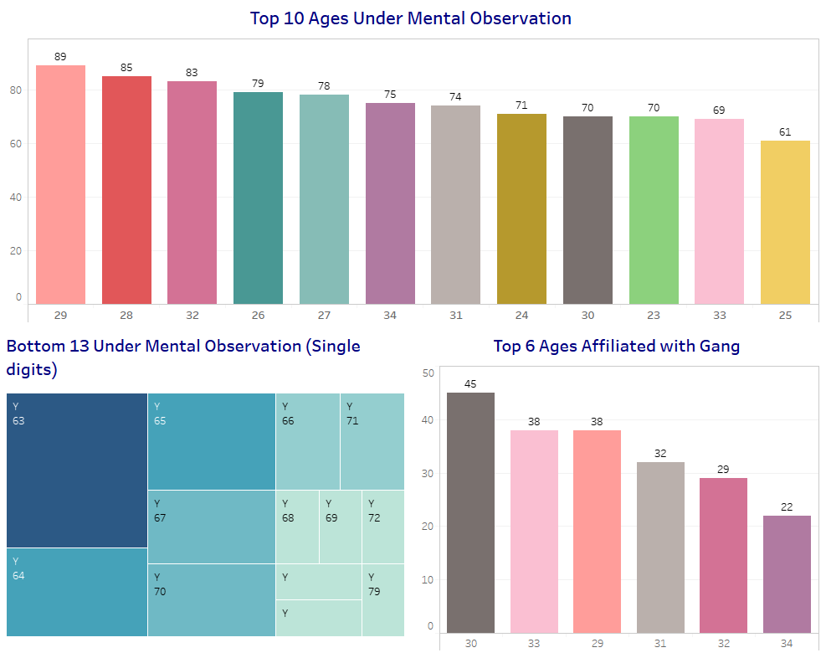
Tableau: Dashboards (Age)
Findings:
Ages 23-34 are the top 10 for inmates under mental observation.
Ages 63-79 seems to have the lowest number of inmates under mental observation (single digits).
Ages 29-34 have the most inmates affiliated with gangs.
Notes:
Devin

Slide 13

Tableau: Stories
We tried to imagine a good use of stories in presentations. We thought a hypothetical Board of Corrections might be interested in seeing the Department of Corrections’ administrative dashboards.
Notes:
Wendy

Slide 14
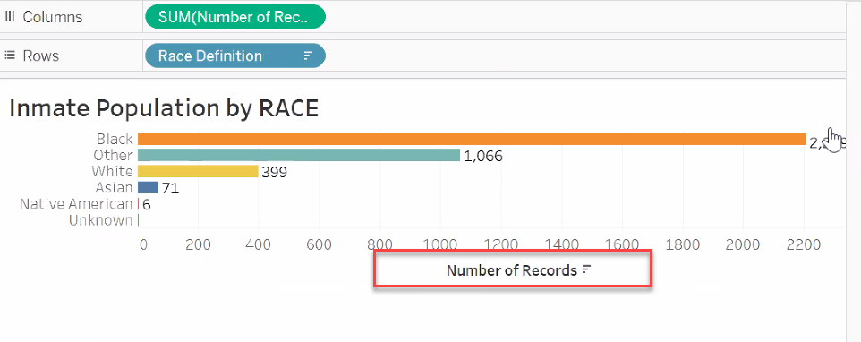
Tableau: Data Ink
When creating sheets we tried to limit the amount of “Data Ink” on each sheet.
Hid headers when title of sheet was self explanatory.
Notes:
Devin

Slide 15
Tableau: Dashboard Management
Hid sheets when we were done with them. While working on other dashboards.
Color code sheets
Notes:
Wendy

Slide 16
Conclusion
Challenges Actual Dashboard Design, Finding Definitions and Deciding on which platform to do select data cleaning.
Lessons Learned Importance of data cleaning and understanding how data joins work.
Notes:
Devin

Slide 17
Resources
NYC Open Data was where we obtained our dataset. The data was provided by the NYC Board of Correction.
https://data.cityofnewyork.us/Public-Safety/Daily-Inmates-In-Custody/7479-ugqb
Uploaded to Github:
https://raw.githubusercontent.com/DMDataAnalytics/Inmates/master/Daily_Inmates_In_Custody%20Raw.csv
StackOverFlow:
For Reference Code To Assist In Export of Cleaned Data Out of Colab.
Notes:
Wendy

